Slide 1

Wireless Open Access Research Platform (WARP)
FPGA Team (GSSST H/W LAB)
Under The Guidance of
Dr. Suvra Sekhar Das
G. S. Sanyal School of Telecommunication
Indian Institute of Technology, Kharagpur
Oct 7th, 2013

Slide 2
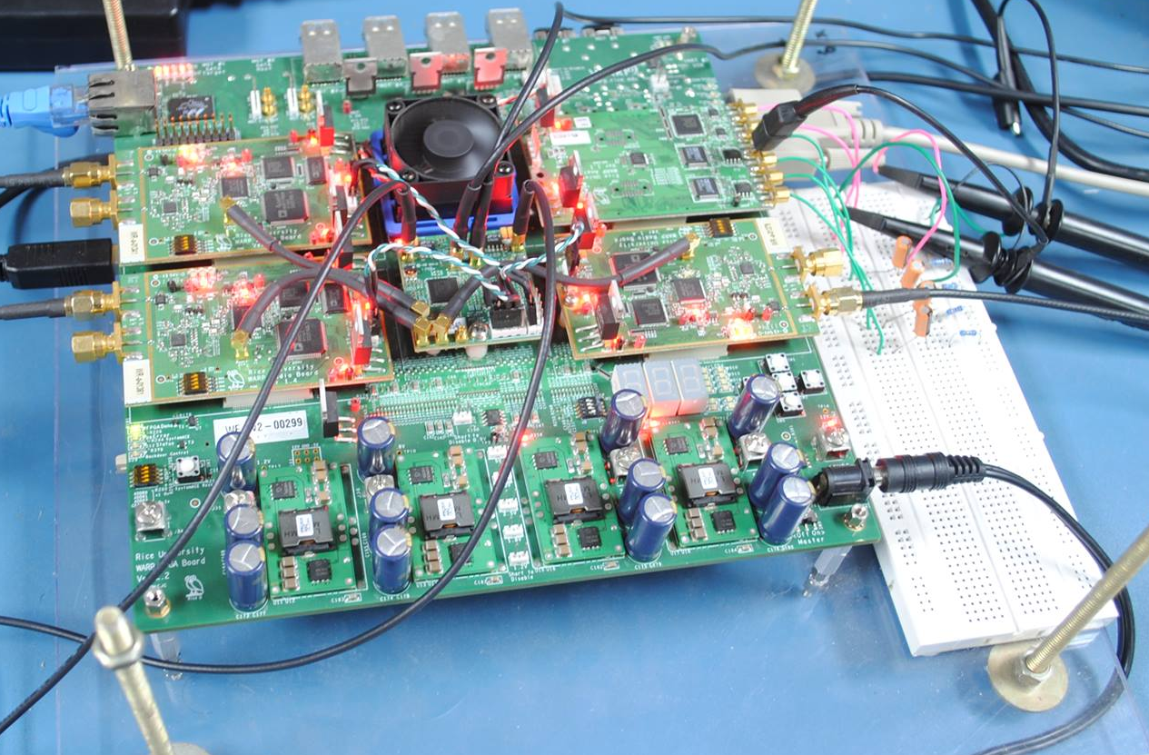
WARP V2 (Virtex-IV) Board
Multi Gigabit Transceiver
(MGT)
Ethernet
Virtex-4 FPGA
Clock Baord
Radio Card
FPGA Power
Supply
External Power
Supply

Slide 3
WARP FPGA BOARD
Rice University’s Wireless Open-Access Research Platform (WARP)
C programmable interrupt driven embedded system
Uses Xilinx’s Virtex IV FPGA for processing and storage
Radio boards can be used as transceiver, can operate at either 2.4 GHz or 5 GHz (ISM band) with 40 MHz bandwidth
Versions of WARP Hardware:
WARP V1(Virtex-II pro)
WARP V2(Virtex-IV)
WARP V3(Virtex-VI)

Slide 4
WARP FPGA Board Power Supplies
Required External Supply:
The WARP FPGA board operates from a single external 12v supply. This supply is generally connected to the board's coaxial power connector.
FPGA Power Supplies
The Virtex-4 FPGA has a number of different power inputs. The table below summarizes the power supplies on the WARP FPGA board.
Supply | Voltage | Description
VCC_EXT | 12v | External supply
VCC_5 | 5.0v | Daughter card slot supply
VCC_INT | 1.2v | FPGA core logic
VCC_AUX | 2.5v | FPGA clock resources
VCC_O | 3.3v, 2.5v & 1.8v | FPGA I/O banks
MGT_x | 2.5v, 1.5v & 1.2v | MGT logic and I/O
VCC_0.9 | 0.9v | DDR2 SO-DIMM termination

Slide 5
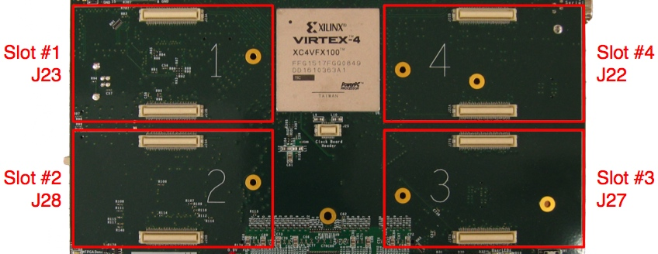
WARP FPGA Board Daughtercard Slots
The WARP FPGA Board has four daughtercard slots. The four slots are electrically and mechanically identical. The WARP hardware supports any combination of daughtercards in the four slots.

Slide 6
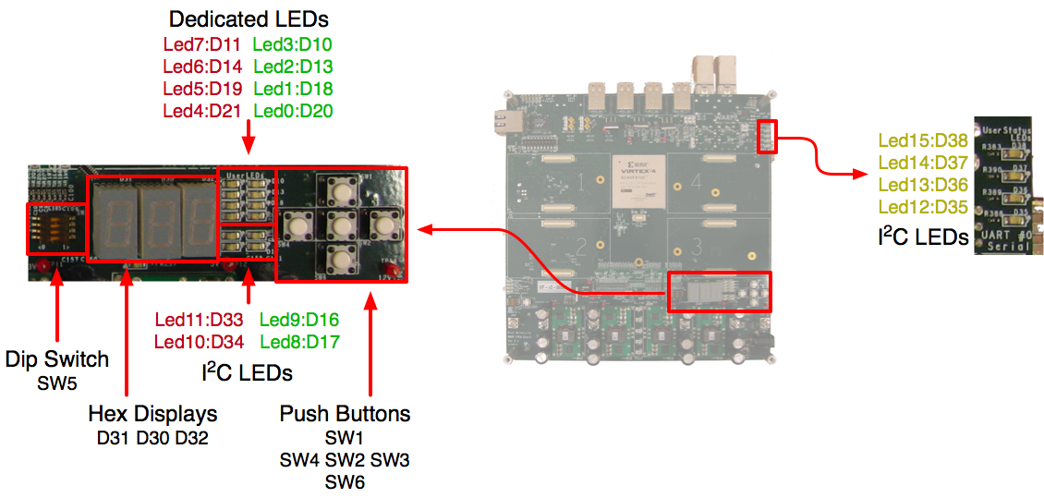
WARP FPGA Board User I/O’s
Push Buttons
LEDs
Hex Displays

Slide 7
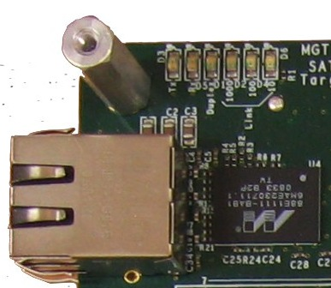
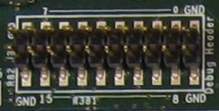
WARP FPGA Board Ethernet and other I/O’s
Ethernet:
The FPGA Board has one 10/100/1000 Mbps Ethernet device present. Virtex-4 FPGA uses one of the hardened Tri-mode Ethernet MAC for the MAC layer.
USB-UART:
The FPGA board includes a USB-UART interface, You can connect this port to a PC via a standard USB cable
RS232-UART:
The FPGA board also includes a standard RS-232 serial port. The board's female DB9 port is configured just like a PC, with Tx on pin 3, Rx on pin 2 and GND on pin 5.
DIGITAL I/O’s:
There are 16-bits of unbuffered 3.3v I/O connected directly to FPGA I/O pins

Slide 8
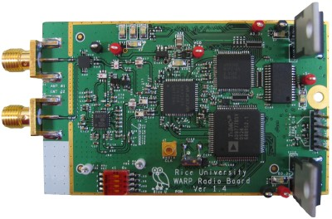
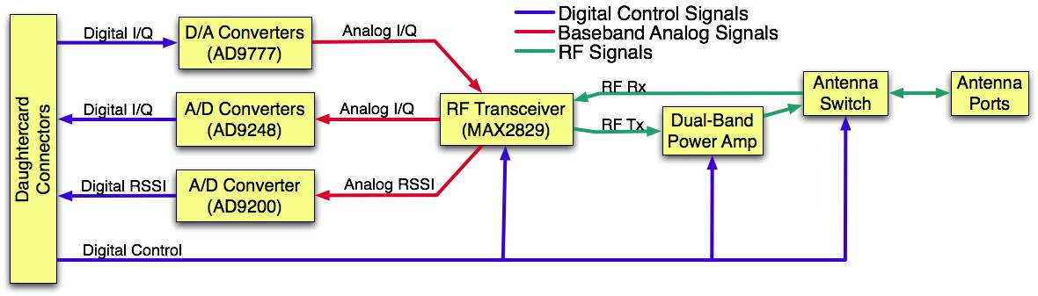
WARP Radio Board
Dual A/D
Converters
AD9248-65
LED’s
A/D Converter
AD9200
Dual D/A
Converters
AD9777
DIP Switches
RF Transceiver
MAX 2829

Slide 9
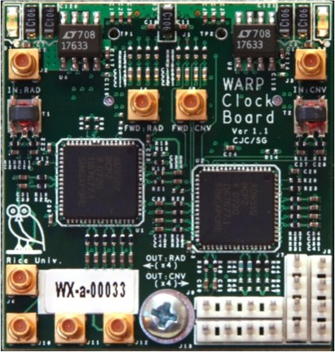
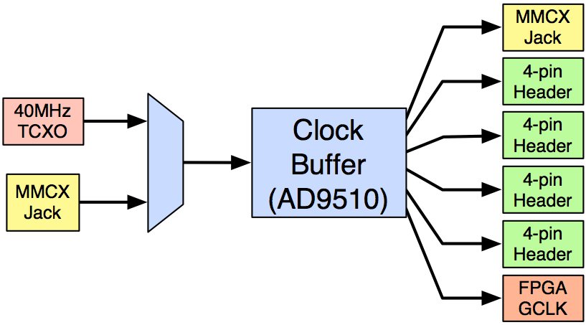
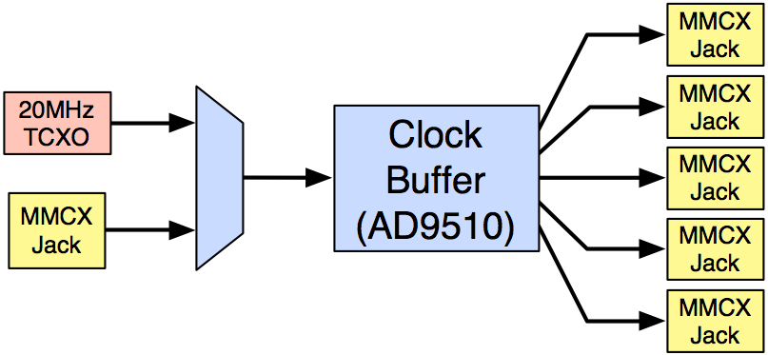
WARP Clock Board

Slide 10
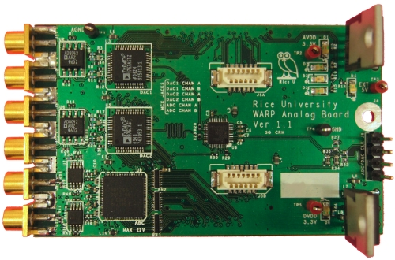
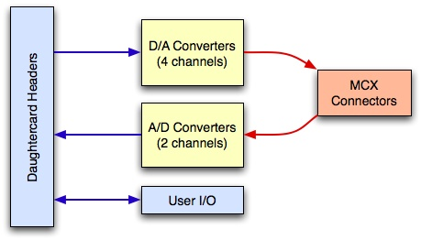
WARP Analog Board

Slide 11
OFDM Transceiver Over The Air Demo FPGA / HW
Ethernet
Host Computer
FPGA
Radio 1
Analog
MATLAB
User Application
WARPLab Framework
Ethernet
Radio 2
Radio 3
-> initialize
-> send Binary Data
-> start tx/rx
<- read Binary Data
WARP Node
Transmitter | Receiver
Input binary data | Output binary data
I/Q Tx | I/Q Rx
DAC | ADC
Up-conversion RF Tx Front end | RF Rx Down conversion
Error correction coding | Error Correction Decoding
Symbol Mapping | Symbol De-mapping
OFDM modulation via IFFT | OFDM Demodulation via IFFT
CP | CP & Time synchronization
Custom bitstream
Custom design
*.m (Matlab)
*.mdl(Simulink)
*.c/c++
Xilinx ISE
System Generator
pcore
Xilinx ISE
EDK
(Bitstream
Out)
WARP
pcore device driver
Hardware Design Flow
24th July 2012
Delhi

Slide 12
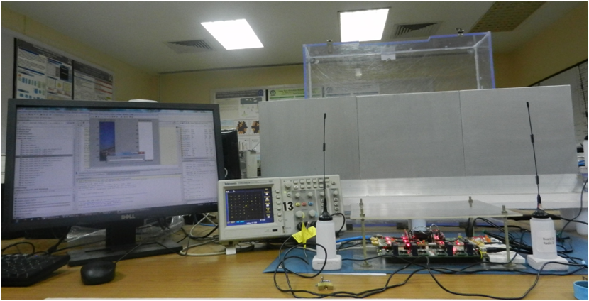
Expemintal Set Up (FPGA based OFDM Test Bed)
Application
Oscilloscope
Warp Board
Antennas

Slide 13
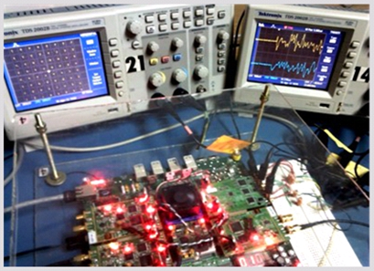
OFDM Symbol output Hardware
OFDM Symbol in Hardware
I,Q Constellation output in Hardware

Slide 14
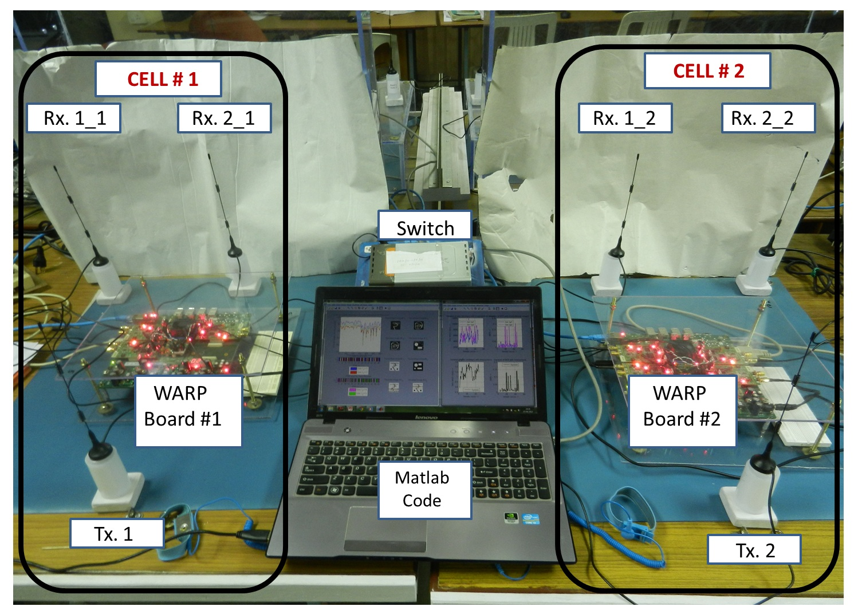
Expemintal Set Up (RRA and Co-ordinated scheduling)

Slide 15
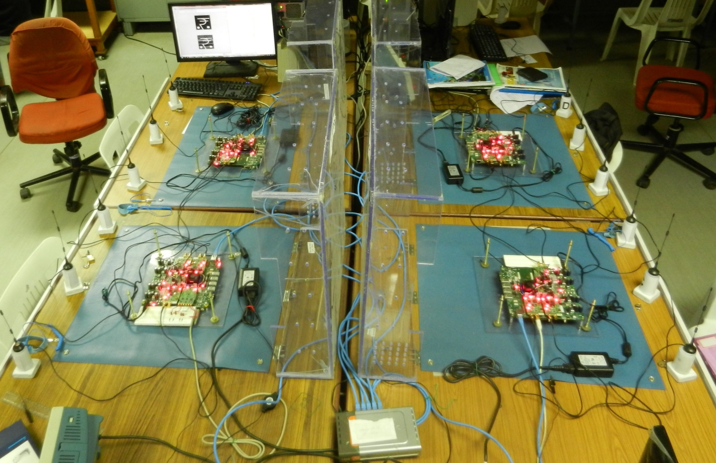
Expemintal Set Up (MIMO)
MIMO
Demonstration
(WARPLAB)
Control
Application
Antennas
Ethernet
Switch
WARP Board

Slide 16
THANK YOU

